Slide 1
FileIO

Slide 2
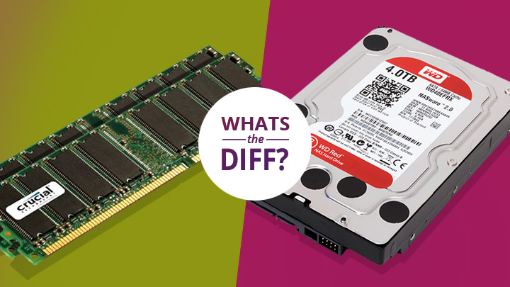
What is FileIO?
File In-Out
How do we read actual data on disc as opposed to creating and manipulating data in memory.

Slide 3
Why do we use it?
It is nice to save data sometimes
We might have data that we need to parse that came in a file
Makes learning programming so much more interesting
Especially the advanced stuff
Parsing data is useful in countless situations
This is a great way to practice

Slide 4
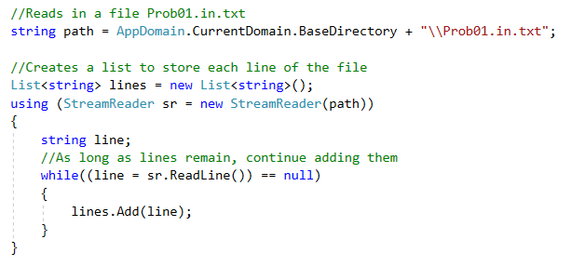
StreamReader (The I in FileIO)

Slide 5
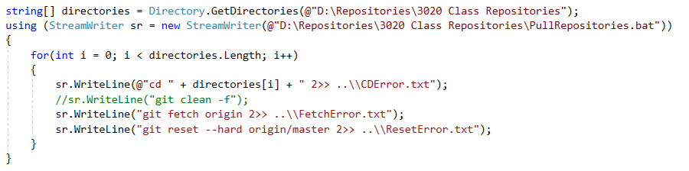
StreamWriter (The O in FileIO)

